Slide 1
Shop Billing Website
Project Title

Slide 2
Name- Darshan Pancholi
Dipartment – diploma IT
Section –B
Enrollment number -24C15034

Slide 3
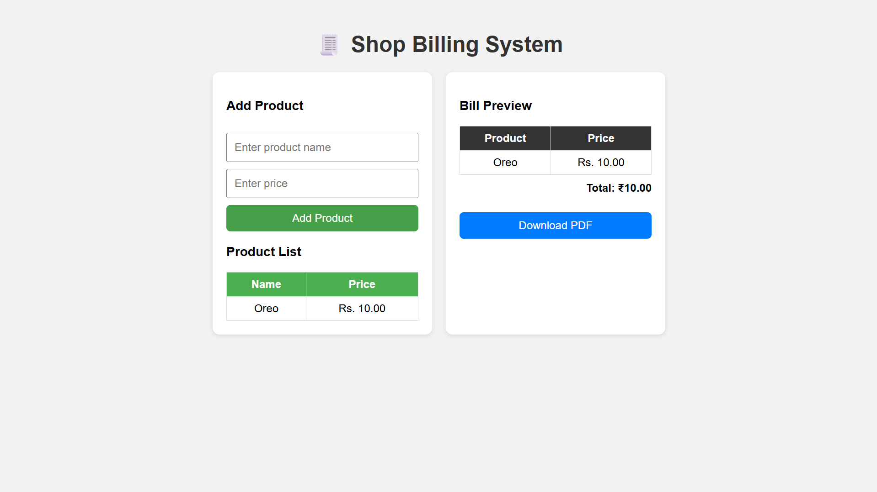

Slide 4
Project Description
The Shop Billing System is a simple web-based application designed to help small shops manage customer bills efficiently. It allows the user to add products, calculate totals automatically, generate invoices, and store billing records. The system improves accuracy and saves time compared to manual billing.

Slide 5
Scope of the Project
Used for small to medium shops for daily billing
Handles product entry, price calculation, and final bill generation
Reduces human error and speeds up checkout process
Can be expanded with inventory, GST, PDF bill export, or customer records
Works on any device with a web browser

